Slide 1

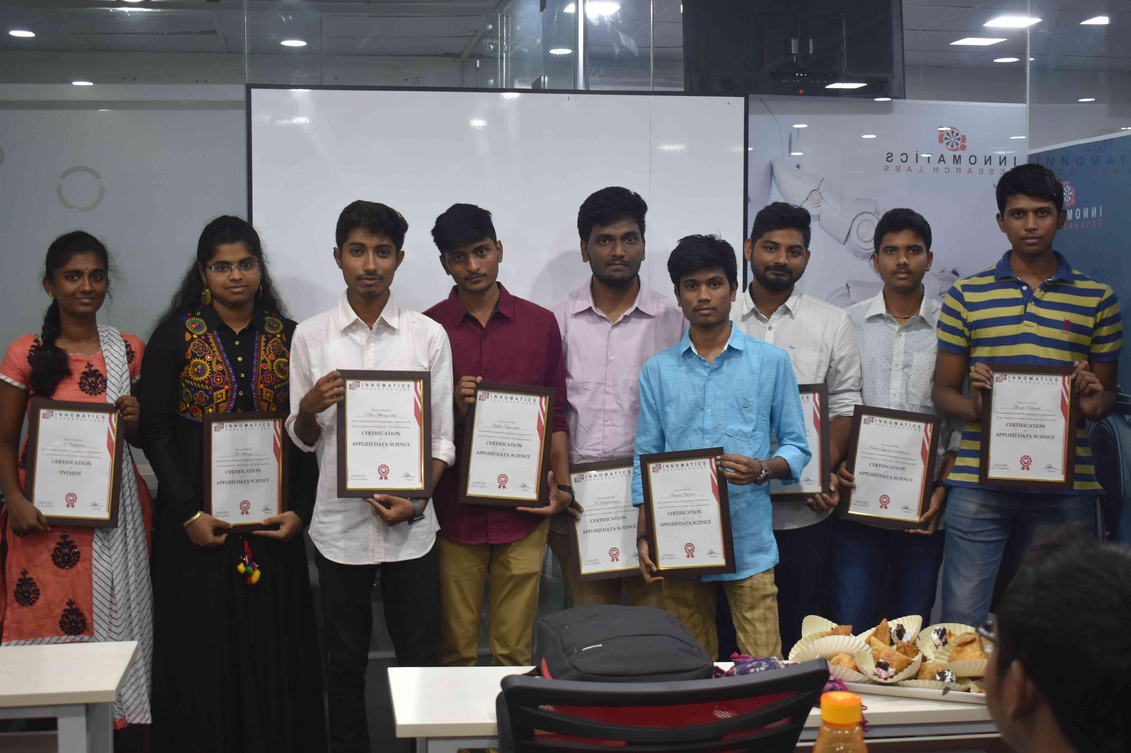
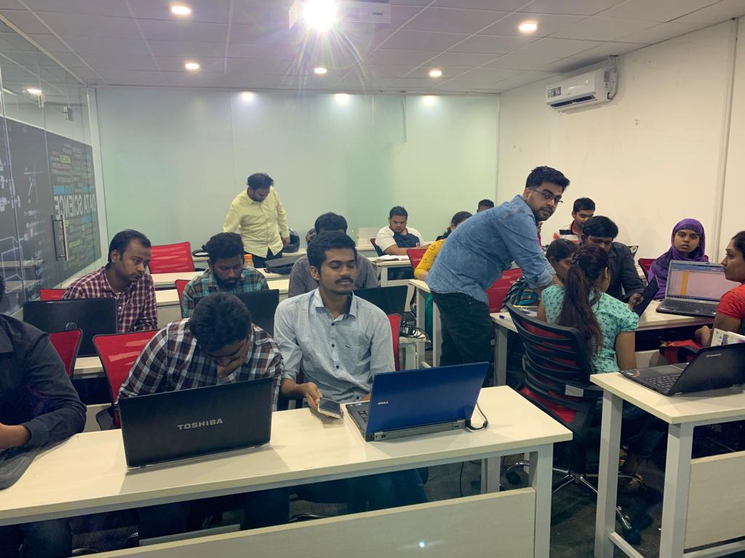

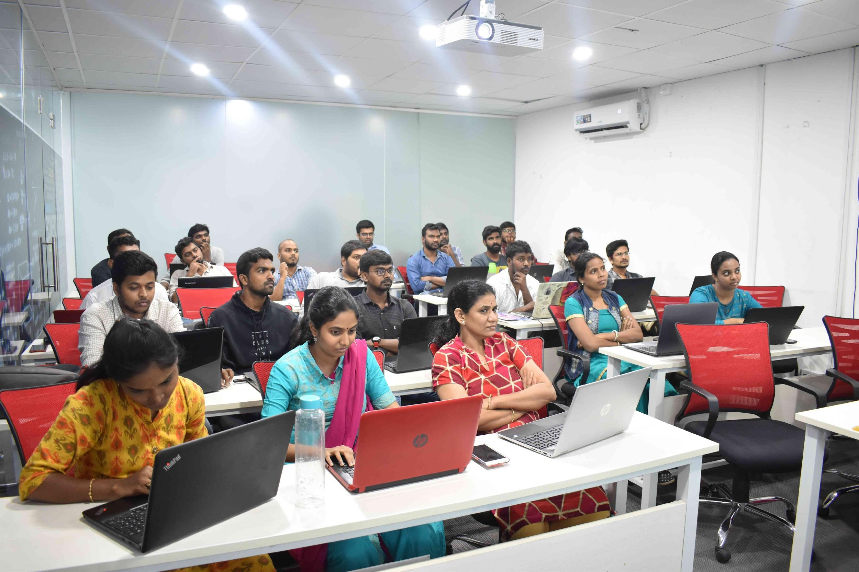
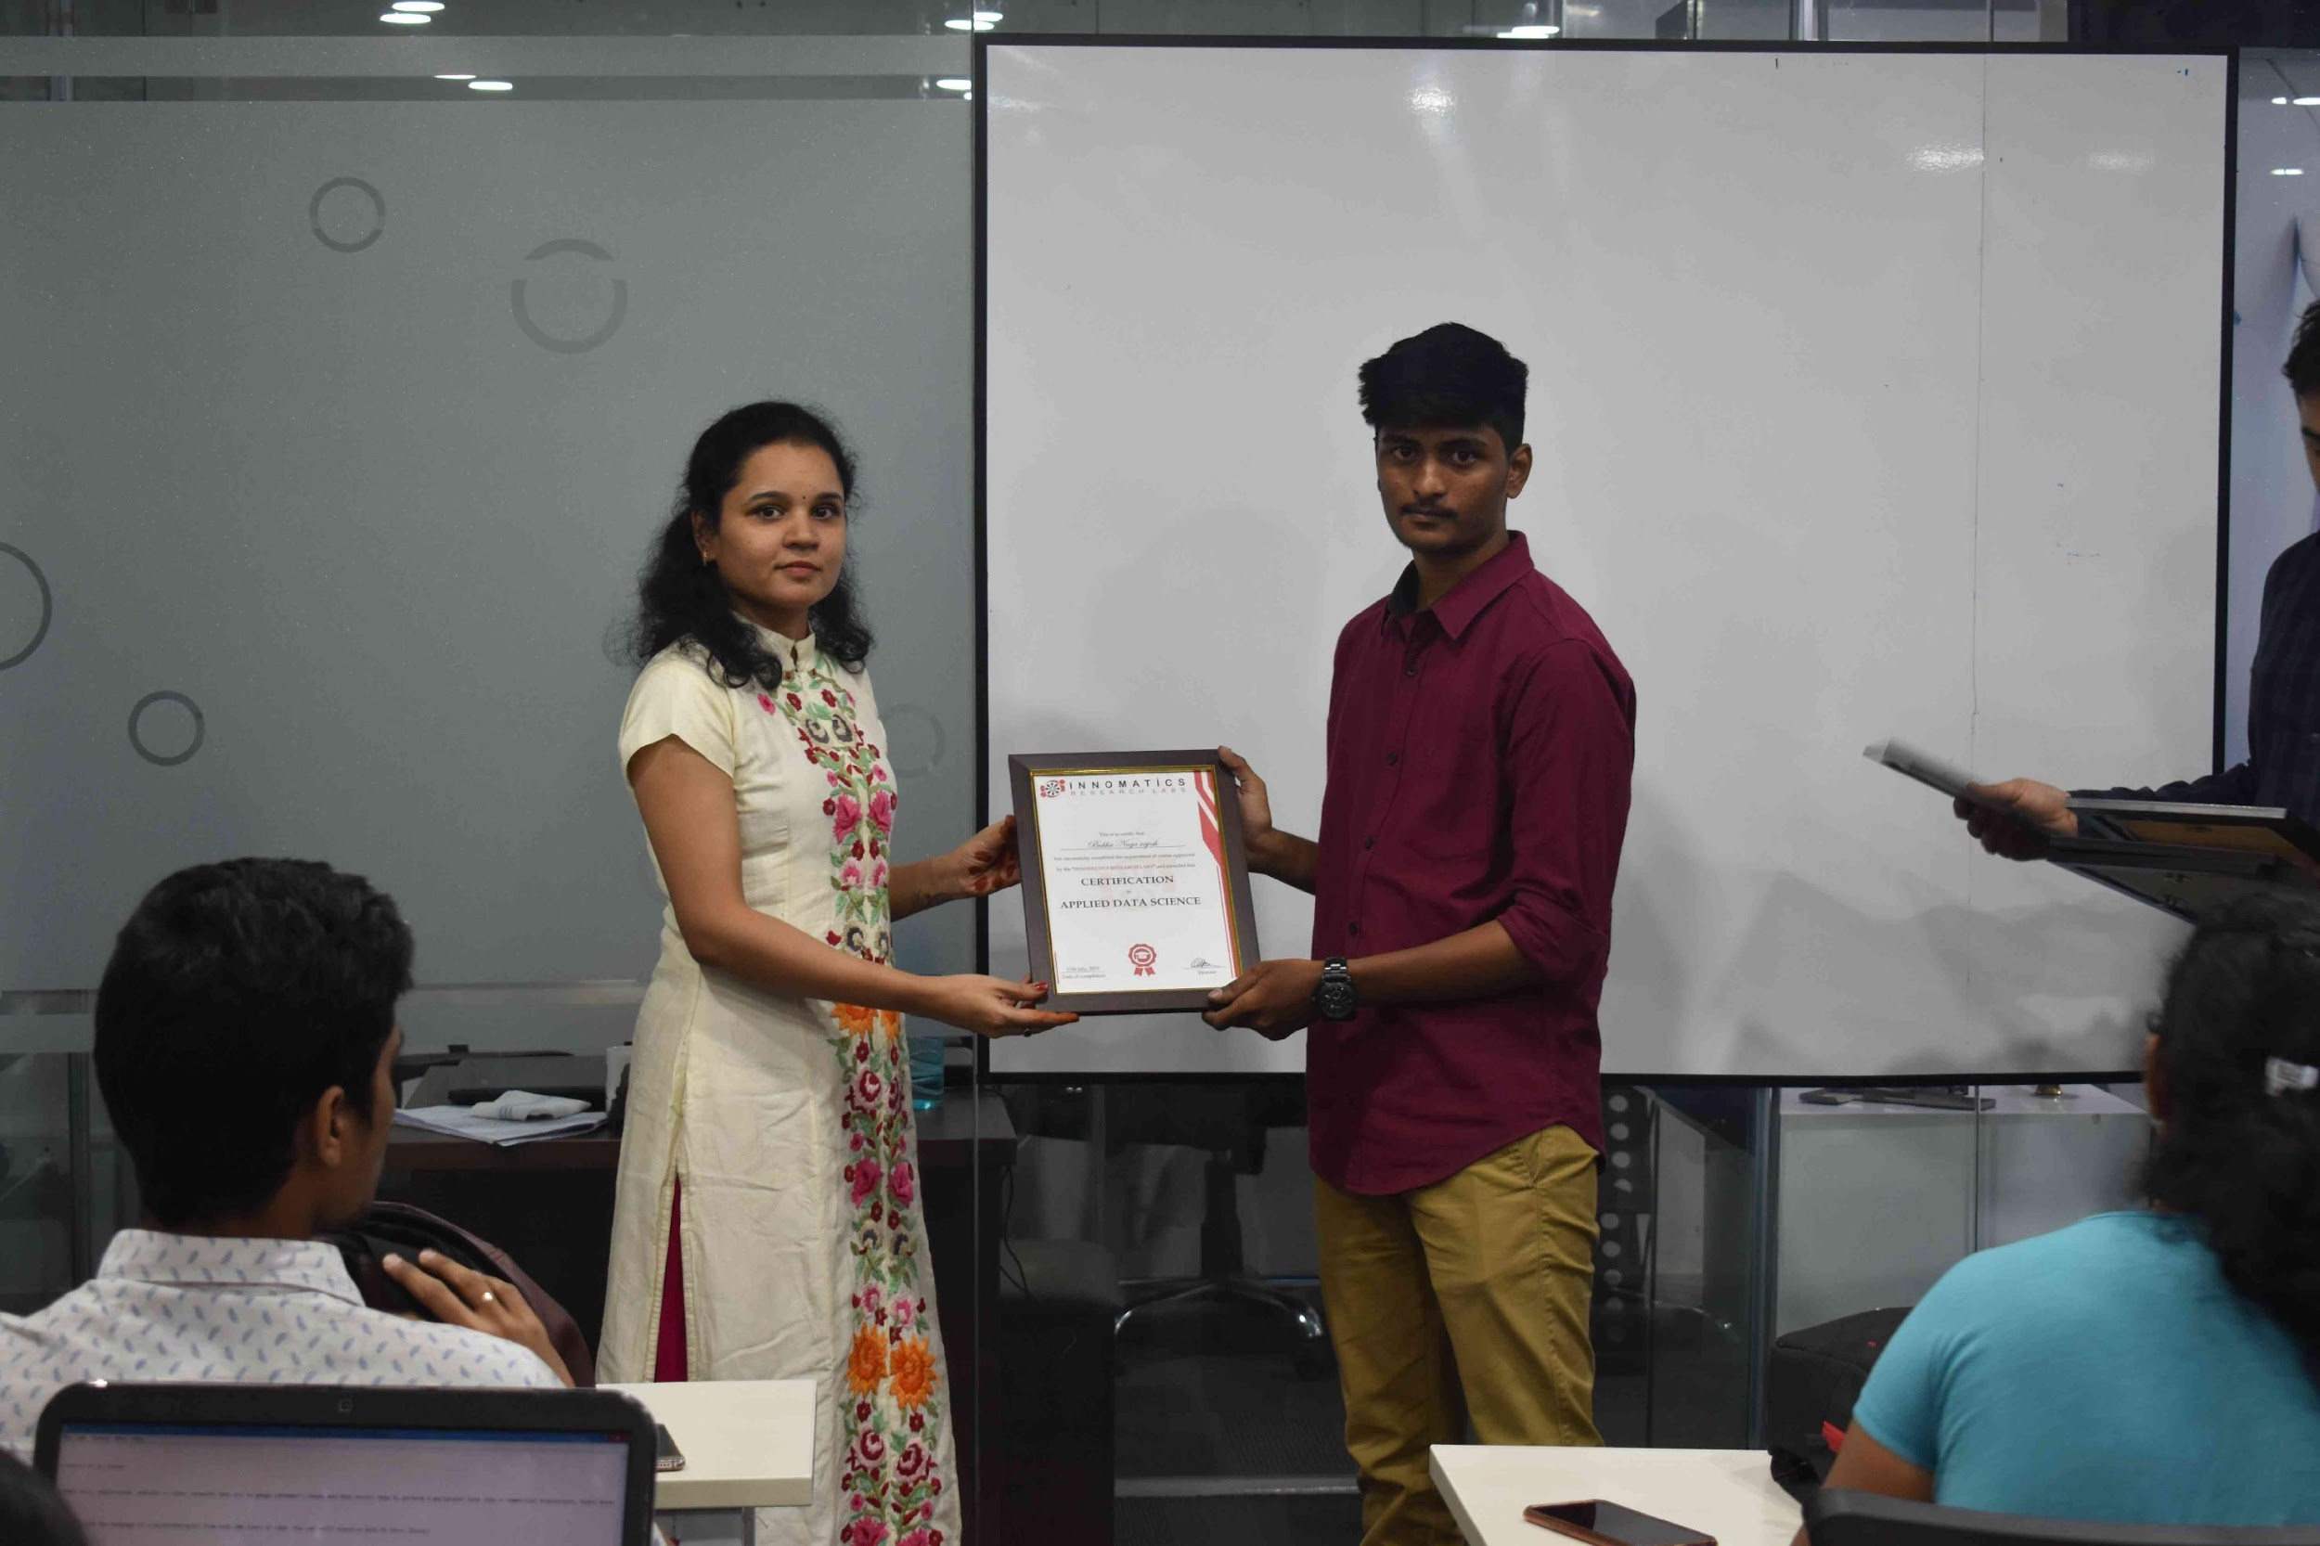
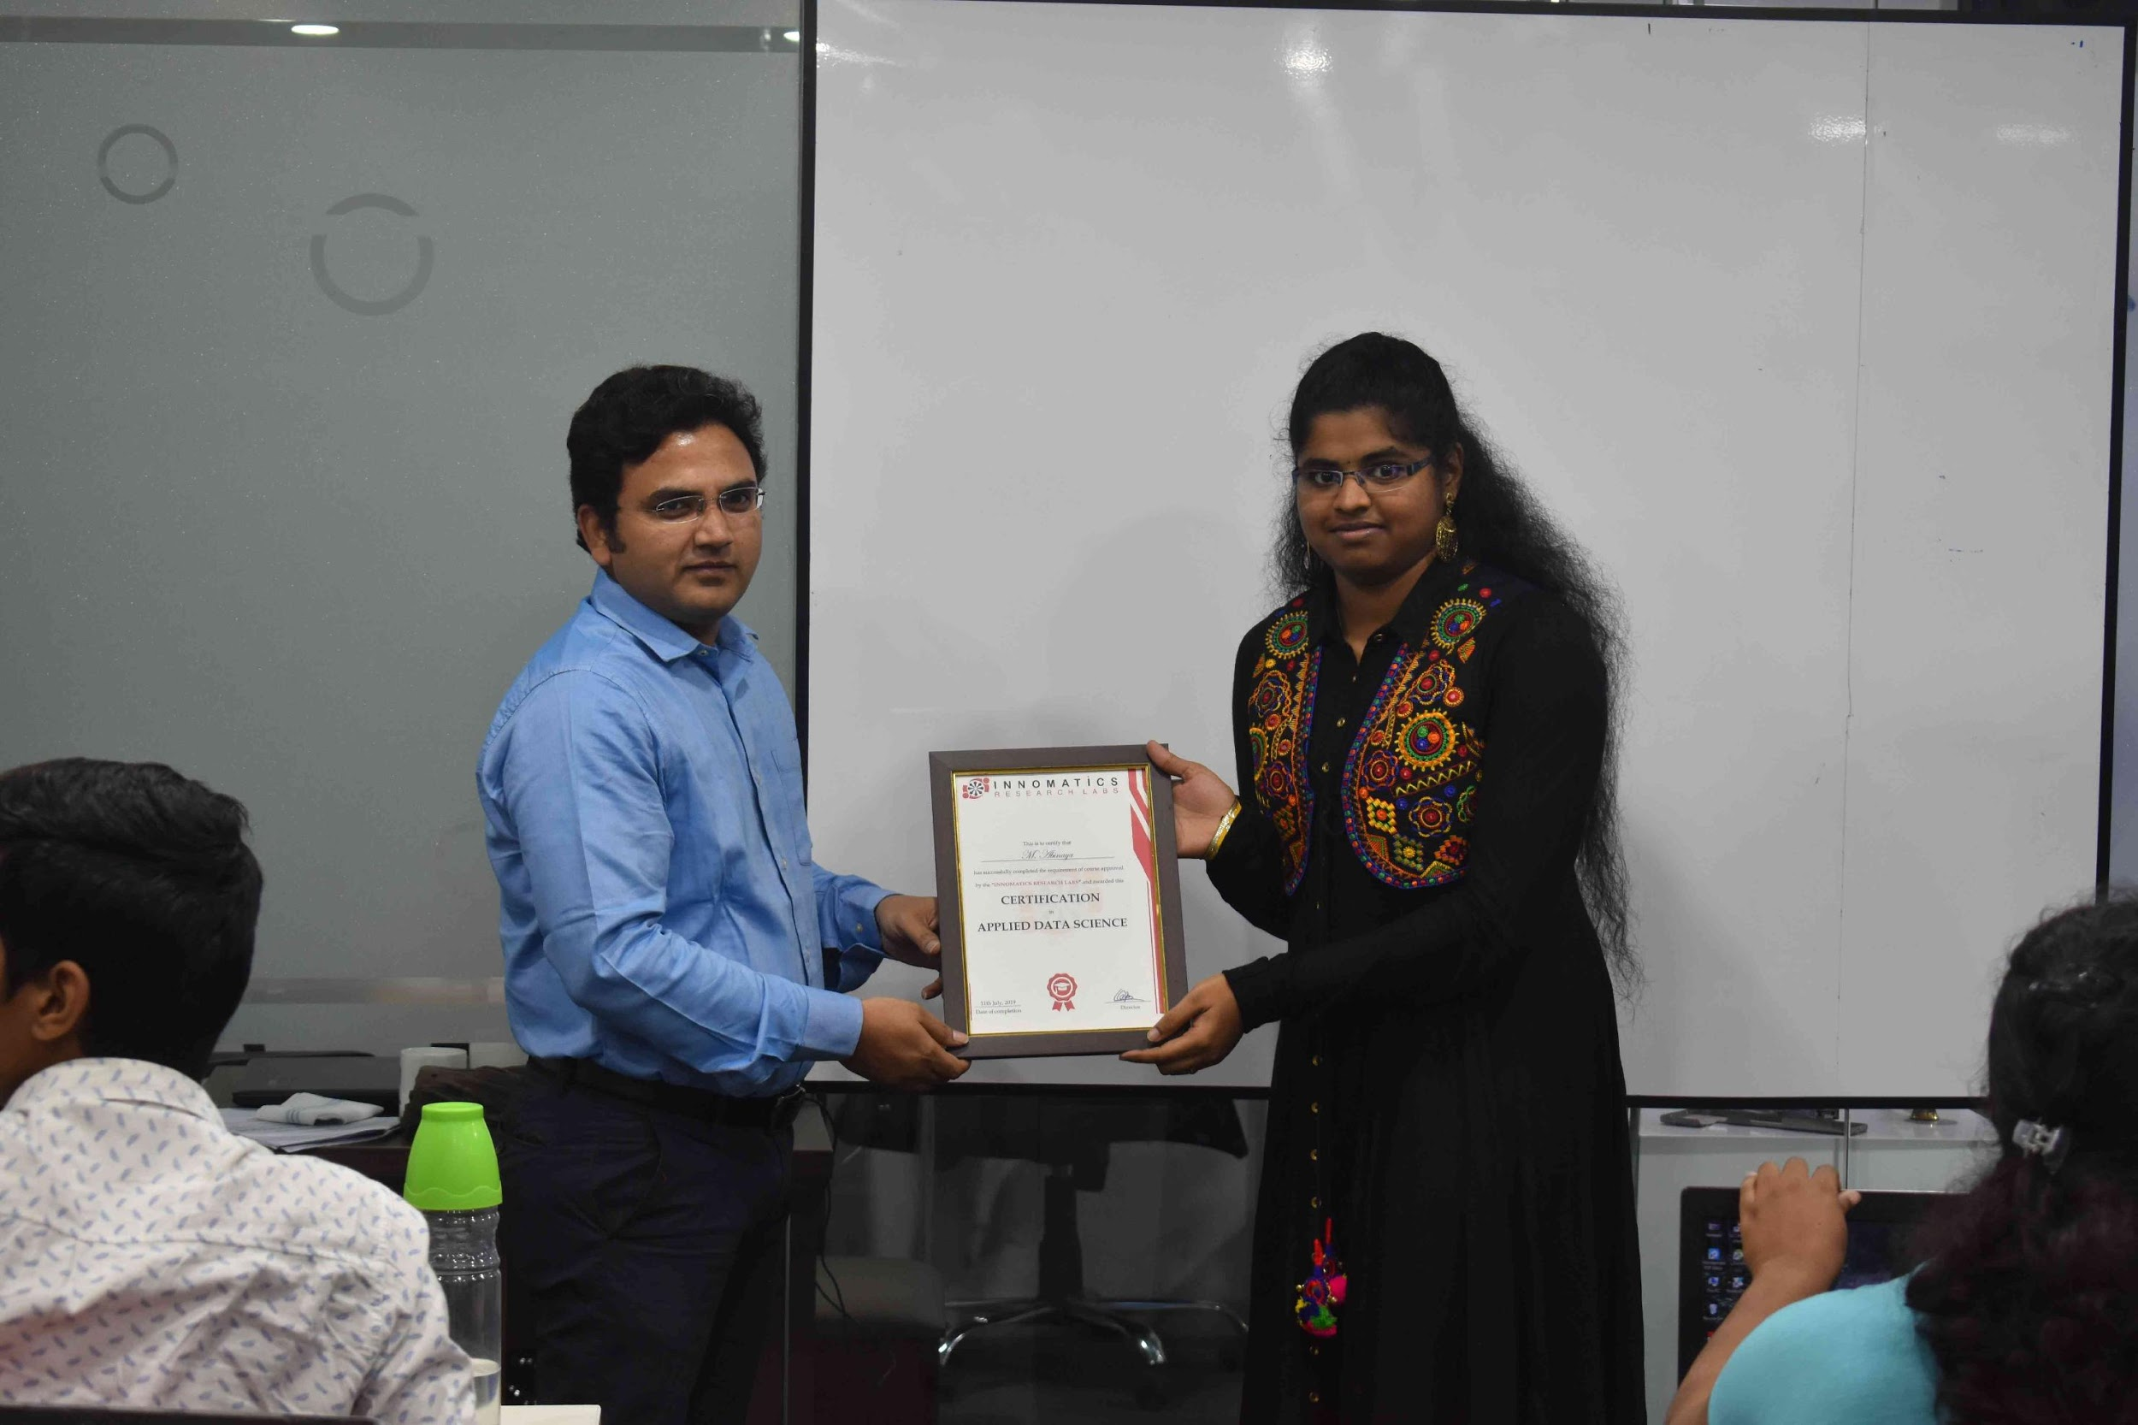

Slide 2
Data scraping and eda on used cars
By Prashanth and Ramesh
Batch 134 data science

Slide 3
About Team
Name : D.Prashanth
Graduation : B-Tech(Mechanical) - 2020
Work Experience : Catalog Associate in Amazon having less than 1 year of Experience
Name : D.Ramesh
Graduation : B-Tech(Computer Science) - 2020
Work Experience : Data labeler in Wipro having less than 1 year of Experience

Slide 4
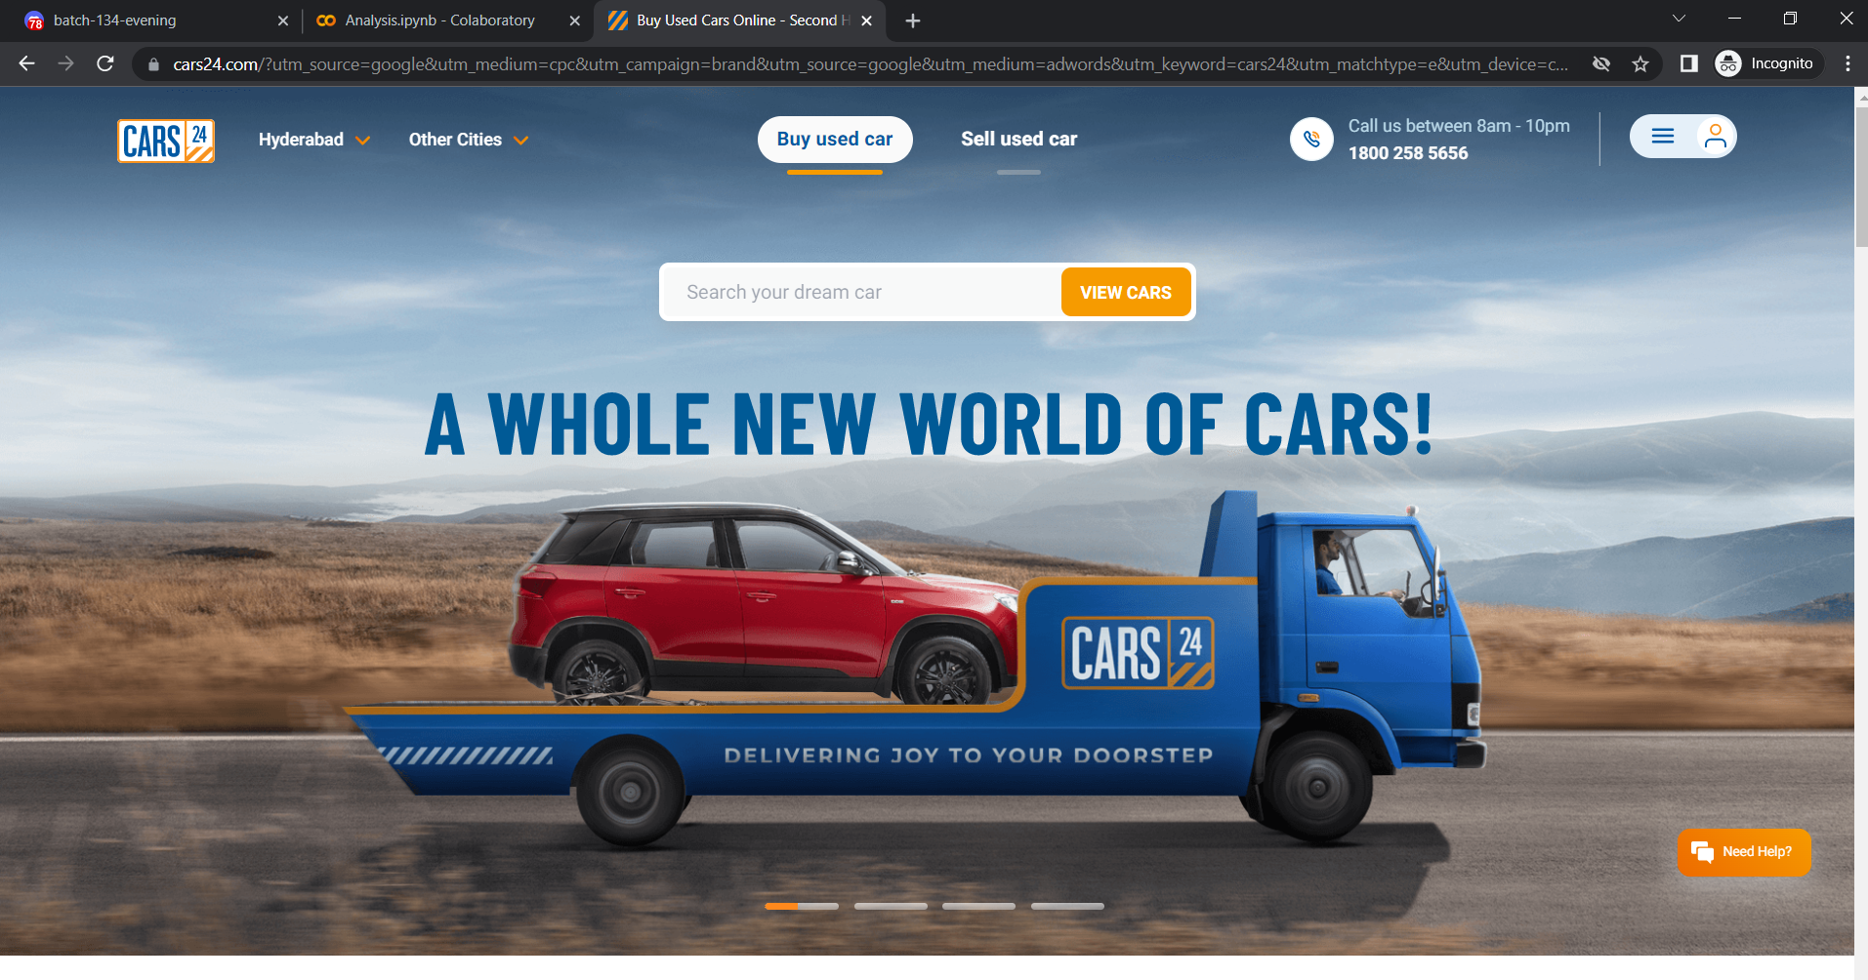
This is how CARS24 website homepage looks. From here we extracted
the used cars data to do an analysis.
We performed this data scraping of various cars in various cities like Hyderabad, Delhi, Bangalore, Mumbai and other metropolitan cities.

Slide 5
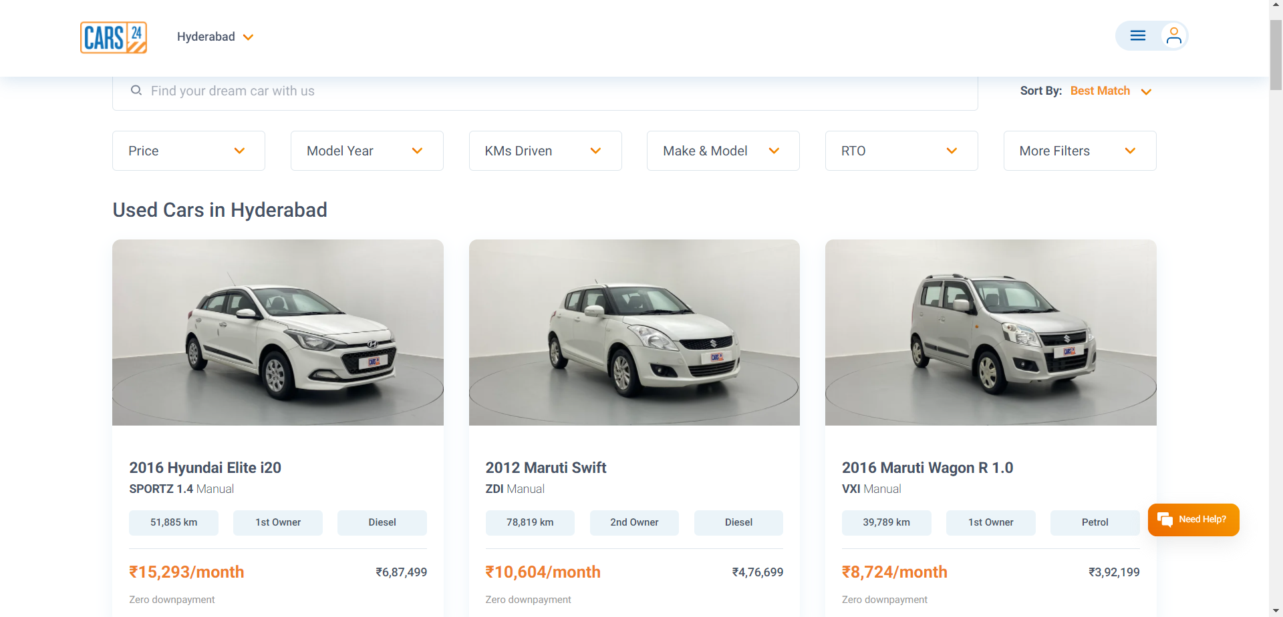
Once by clicking View cars we get the data of different cars of different models.

Slide 6
Features to be considered are :
Cars name
Cars brand
Cars model
Model year
Type(manual/automatic)
Kilometers travelled
Owner (1st , 2nd , 3rd etc. )
Gasoline type
Price
Emi/month
City and state

Slide 7






Libraries used

Slide 8
Data extraction
we extracted the raw data from cars24 using Selenium and Beautifulsoup.
We run the same process for different cities.
This extracted data for different cities was taken into a CSV(comma separated value) file.
Then we merged those data into single file.
We named it as cars24.csv

Slide 9
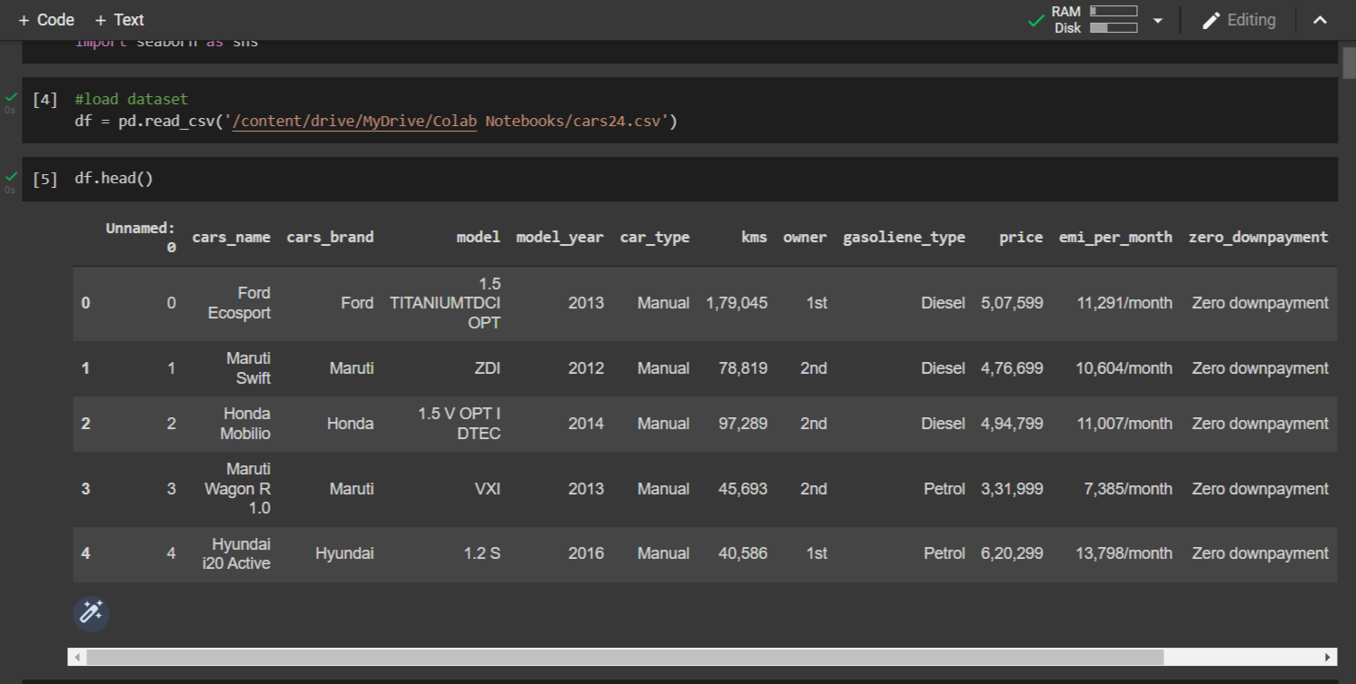
The above image shows how extracted data looks like.

Slide 10
Data cleaning
Removed unwanted columns in the data frame.
Removed commas in a numerical values.
Remove ‘/month’ from Emi_per_Month column.
Removed strings like ‘st,nd,rd’ from Owner column.
Checked the data types and changed the data type to its respective data type.
Found null values in Car_type column and converted those null values into mode of that column

Slide 11
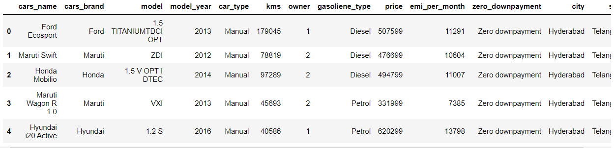
The above picture shows how cleaned dataframe look like.

Slide 12
Analysis

Slide 13
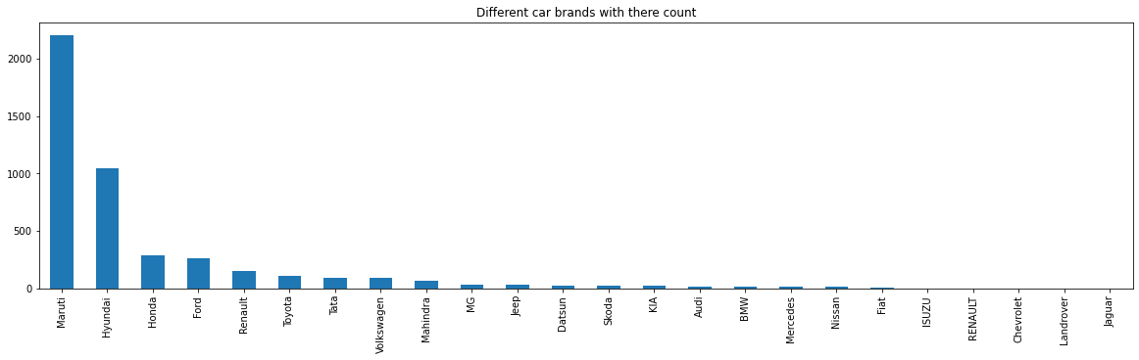
Different Car brands with there count
In data frame there are 24 unique brands of cars
The most listed car brand in cars24 is Maruti with more than 2000 cars
The low listed car brands in cars24 are shown in above plot which are less than 30

Slide 14
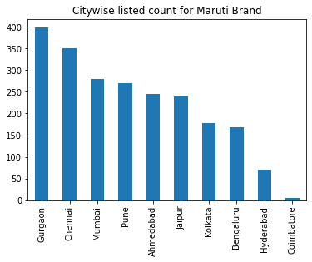
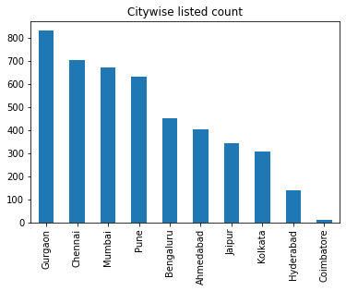
Citywise listed count and Citywise listed count for Maruti brand
Maruti Brand
All Brand Cars
The more number of Maruti cars are listed in Gurgaon city because of Gurgaon city has more listed number of cars in cars24.

Slide 15
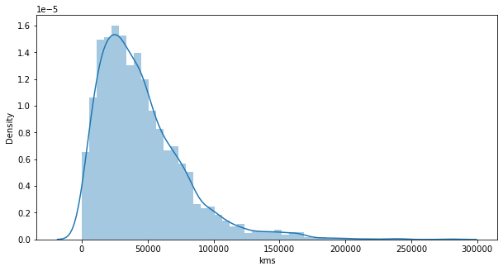
Kilometre Distribution
In this dataframe the most cars kms(density) are less than 100000

Slide 16
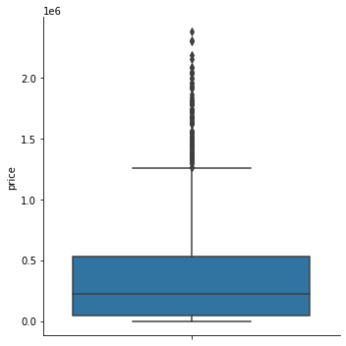
Price Distribution
In this dataframe the most car prices are around 1 - 5 lakhs
The upper bound of this dataframe is around 13 lakhs
lower bound around 1 lakh

Slide 17
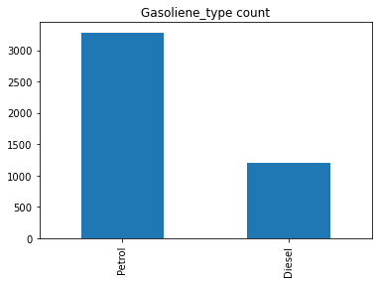
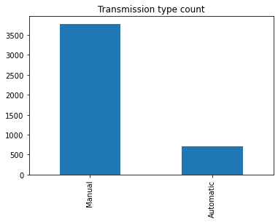
Gosoliene Type count and Transmission Type count
There are more petrol cars than Diesel
There are more Manual cars than Automatic

Slide 18
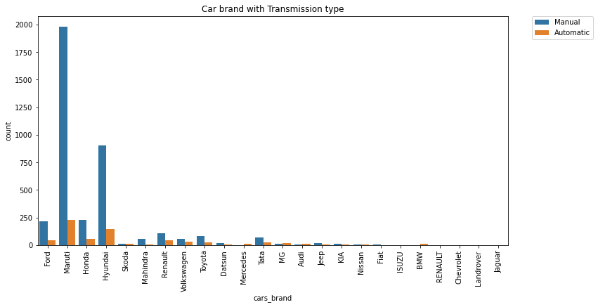
Car brand with Transmission Type
Maruti has high number of cars in both Manual and Automatic
In which there are more manual cars then Automatic.

Slide 19
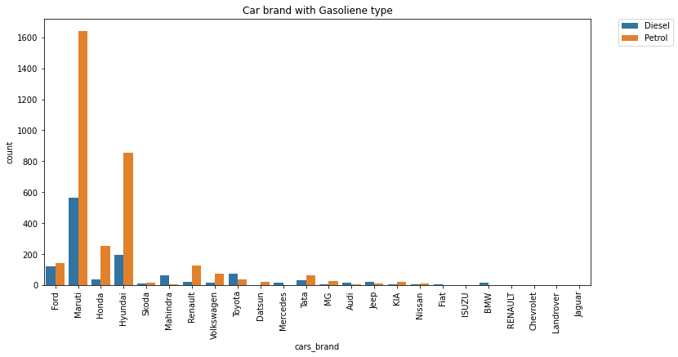
Car brand with Gasoliene Type
Maruti has high number of cars in both petrol and diesel
In which Petrol cars are more when compared to diesel.

Slide 20
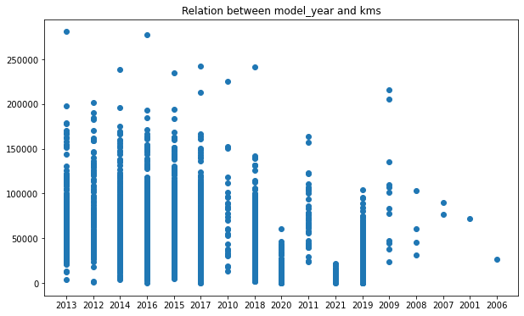
Relation between model year and Kilometres
In this the most of model cars are from 2010 to 2020
car model increases the kms maximum number decrease

Slide 21
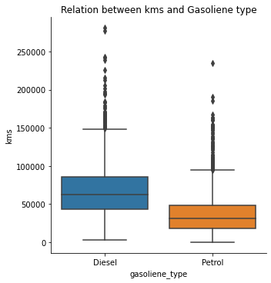
Relation between kilometres and Gasoliene Type
The median for diesel type cars is high
The Upper bound for diesel type cars is high
The density of diesel type cars is high which is in range of 45000 to 90000
The density of petrol type cars is in range of 30000 to 52000

Slide 22
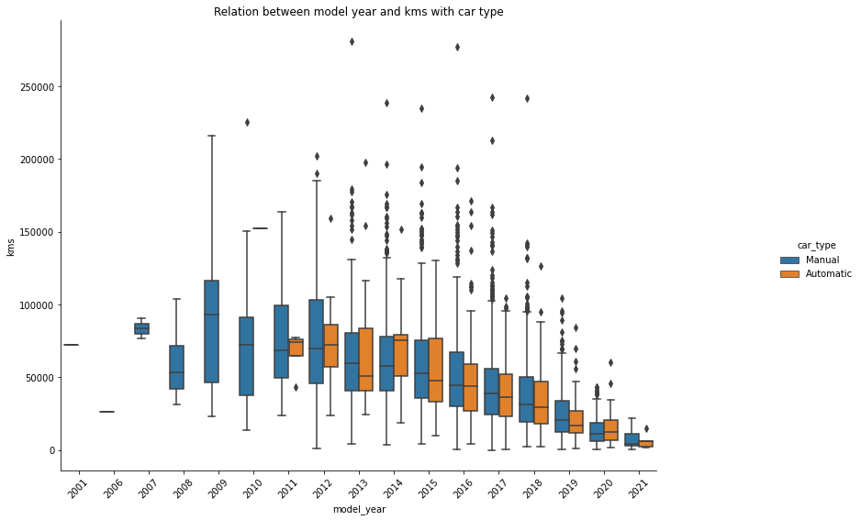
Relation between Model Year and Kilometres with Transmission Type
upto 2010 there is only manual cars
The median of Automatic and manual decreasing but in 2014 there is high median for automatic cars when compared to other years
The upper bound and median is high in 2009 and it has only manual cars
The upper bound for automatic cars high in 2015
The kilometres density of cars in 2001 and 2006 is negligible
There is no carsmodel listed from year 2004 to 2005

Slide 23
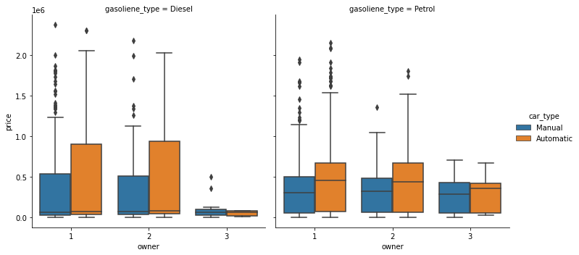
Relation between Transmission Type and Gasoliene Type with Owner
In diesel type cars the median is very low but the 50 - 75 percentile density is high
The upper bound in Diesel is high
In diesel cars the upper bound is high in automatic cars means the price upper value is high in automatic cars which is for 1,2 owner
In both petrol and diesel cars the price is high for automatic cars but in 3rd owner it is almost same
In petrol cars the price for 3rd owner is high when compared to diesel cars in both automatic and manual

Slide 24
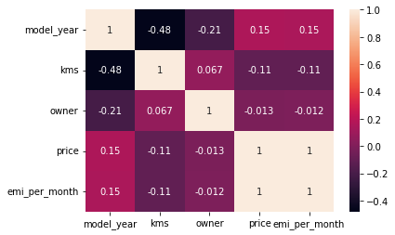
The most of data is poor negative and poor positive correlation
There is 1 for price and emi_per_month which is perfect correlation

Slide 25
User cases

Slide 26
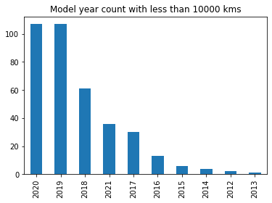
Model Year count with less than 10000 kilometres
The most car models with less than 10000 kms are 2019,2020,2018

Slide 27
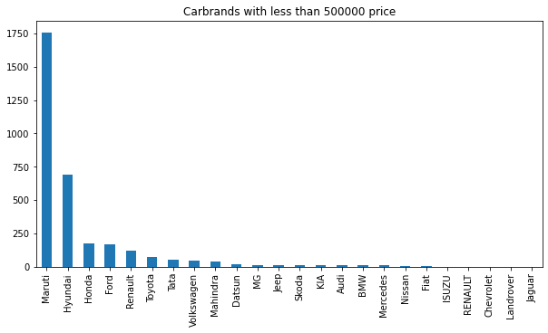
Car brands with less than 5 lakh Price
Checked cars brand which are having price less than 5 lakh
Almost all cars brand are listed less than price of 500000 in which Maruti has high number of cars

Slide 28
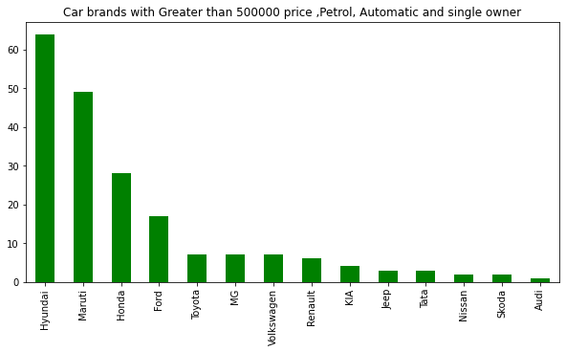
Car brands with greater than 5 lakh price, Petrol, Automatic and Single owner
Hyundai cars listed more for the price of 500000 or more and car type is automatic and gasoline type is petrol and owner is single

Slide 29
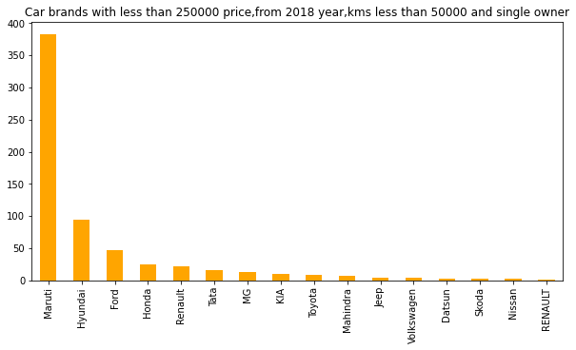
Car brands with less than 2.5 lakh Price,from 2018 Year, kms less than 50 thousand and single Owner
Maruti is listed high numbers of cars for above conditions and Maruti is available for best price with good condition.

Slide 30
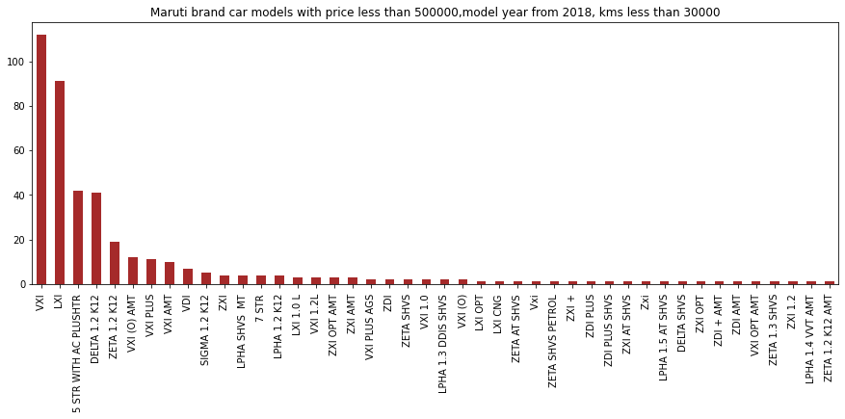
Maruti brand car models with Price less than 5lakh,model year from 2018, kms less than 30thousand
vxi is the best model car to purchase in brand maruthi with a good reasonable price and with a well expected condition

Slide 31
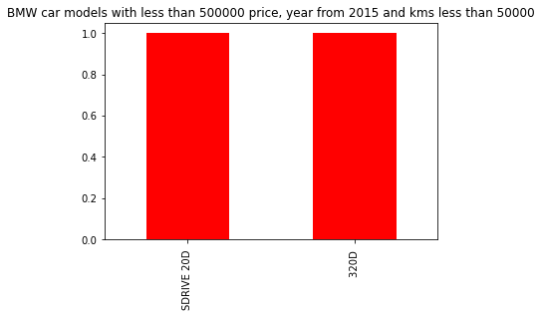
BMW car modles with less than 5lakh price,year from 2015 and kms less than 50thousand
There are only 2 different BMW cars that are available to buy at low distance travelled and above 2015 year

Slide 32
Conclusion
We can see that the price is depend on various factors
Model year
Kilometers Travelled
Owners
Brand of Car
Transmission type and Gasoliene type
Conclusion we find that the Maruti brand has Good number of cars which beat the above criteria and available for best price range in which VXI is the best model car to purchase with a good reasonable price and with a well expected condition.

Slide 33
CHALLENGES Faced
Challenges we faced about getting the data from whole page because the website is linked to javascript which had infinite scrolling like cars visibility depends upon scrolling. To overcome this we use selenium library to capture the whole page, other than this we didn’t faced any challenges.

Slide 34

THANK YOU

